Slide 1
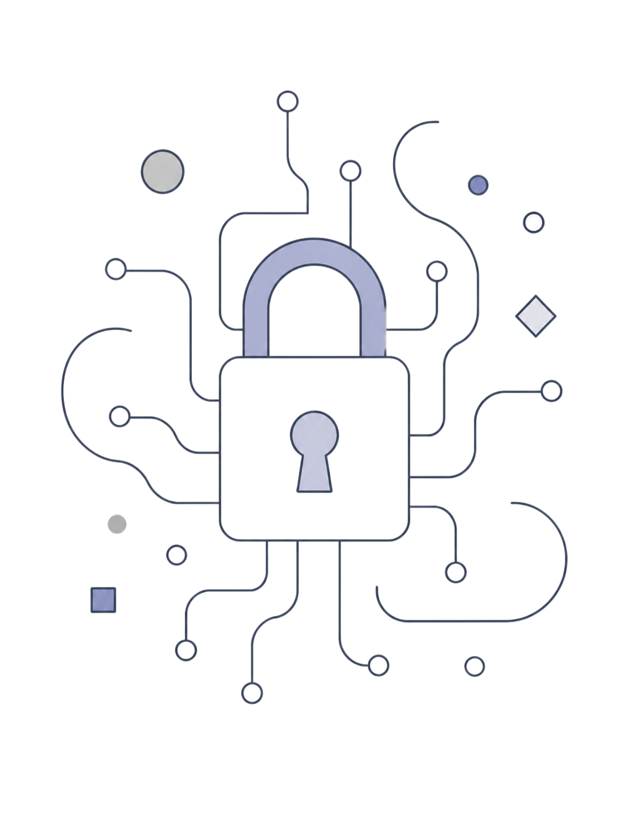
Security Attacks, Threats, Risks and Their Impact on Security Goals
Cryptography & Network Security(CSA5110)
Presented by: E.Shani Priya(192371033)
Chandra Kala Toram(192372224)

Slide 2
Cryptography
Cryptography's Role:
Encryption — protects confidentiality (AES for symmetric, RSA/ECC for asymmetric)
Hash Functions — provide integrity checks (SHA-256 detects tampering)
Digital Signatures & PKI — ensure authentication and non-repudiation
Technical Measures:
User & Organizational Measures:
Strong, up-to-date encryption and secure key management
Firewalls, IDS/IPS, antivirus, secure configurations
Timely patching, backups, redundancy, recovery plans
Strong passwords, MFA, least privilege access
Employee awareness training and phishing drills
Clear policies, incident response, regular audits
Prevention through layered defenses is far less costly than recovery after a breach.

Slide 3
Security Goals: The CIA Triad & Attack Impact
Confidentiality
Integrity
Availability
protect data from unauthorized disclosure
Controls:
ensure accuracy and immutability of data
Controls:
ensure systems and data are accessible when needed
Controls:
encryption
access control
least privilege
hash functions
MACs
digital signatures
secure logging
backups
redundancy
DDoS defenses
disaster recovery
Affected by:
Affected by:
Affected by:
Phishing
Malware
SQL Injection
MITM
Phishing
Malware
SQL Injection
MITM
Ransomware
DDoS attacks
Consequences: financial loss, data breaches, service disruption, identity theft, reputational damage, regulatory penalties

Slide 4
Classification of Security Attacks
Passive Attacks
Active Attacks
— observe data without altering it
— alter or disrupt data and services
Eavesdropping and traffic analysis
Hard to detect
Mitigations: strong encryption, link-layer protection
Masquerade, replay, modification, denial-of-service
Easier to detect
Mitigations: authentication, integrity checks, IDS/IPS

Slide 5
Common Cyber Attacks Overview
Phishing
Malware & Ransomware
— social engineering to harvest credentials or deliver malware
— malicious software that steals data, disrupts services, or encrypts files for ransom
SQL Injection
XSS (Cross-Site Scripting)
— injects malicious queries to read or modify databases
— injects scripts into web pages to hijack sessions or deface pages
MITM (Man-in-the-Middle)
DDoS & Brute Force
— intercepts or alters communication between parties
— overloads services or systematically guesses credentials

Slide 6
Information Security & Threat Landscape
Information security protects data and systems from unauthorized access, misuse, alteration, disclosure, or destruction. Key concepts:
Threats
Vulnerabilities
Risk
Potential events that can exploit weaknesses (malware, phishing, insider threats, disasters)
Weaknesses in hardware, software, or human behavior (weak passwords, unpatched systems)
The impact when a threat exploits a vulnerability (data loss, service outage)
The relationship: Threat + Vulnerability = Risk

Slide 7
Conclusion:
Threats, Vulnerabilities, and Risks Form a Critical Chain
1
2
3
Security Attacks Target the CIA Triad
Diverse Attack Vectors Require Layered Defense
Threats are potential dangers that exploit vulnerabilities in systems and processes. When a threat successfully exploits a vulnerability, it creates a risk that can result in significant harm.
Every major cyber attack—from phishing to DDoS—compromises one or more pillars of the CIA Triad (Confidentiality, Integrity, Availability
Passive attacks like eavesdropping and active attacks like malware each demand different mitigation strategies.
4
5
Cryptography is a Cornerstone, Not a Complete Solution
Prevention and Preparedness Are Far More Cost-Effective Than Recovery
Encryption, hashing, and digital signatures are vital tools for protecting confidentiality, integrity, and authentication. However, cryptography alone cannot prevent all attacks.
Investing in strong security measures, updates, employee awareness, and disaster recovery plans is cheaper than dealing with breaches, data loss, and reputational damage.

Slide 8
